Slide 1
Design and Development of a Visual-Inertial Autonomous Platform and Omnidirectional Locomotion

Slide 2
Problem Statement
This project addresses the inefficiency and manual dependency in intra-warehouse item transport in fast-delivery services, in the context of quick-commerce platforms like Zepto and Swiggy Instamart, where human workers currently perform repetitive pick-and-drop tasks. This is important because manual labor limits scalability, increases operational costs, and introduces delays or errors, especially during high-demand periods.

Slide 3
Current Method for Perception – LiDAR Sensor
Expensive - LiDAR sensors are costly
Bulkier, often heavier
Higher power draw
Struggles with glass, shiny surfaces
Mostly gives depth data, pose needs extra processing
Needs fusion with IMU or camera separately
Cannot interpret color/texture, only geometry

Slide 4
Proposed Method for Perception – Visual Inertial Odometry
Cheaper - cameras + IMU are affordable
Compact & lightweight
Low power
Works in textured environments (indoor, warehouse)
Can estimate full 6-DOF pose with IMU
Naturally fuses visual + inertial data
Can detect visual features like signs, markers

Slide 5
Project Description:
This project aims to design and implement an indoor autonomous mobile robot tailored for environments like warehouses and laboratories. The system integrates low-level motor control using a stepper motor, driver, and Arduino-based controller, which interfaces with a Jetson Nano running ROS 2 (Robot Operating System). The Jetson Nano acts as the central processing unit that handles perception, navigation, and communication with a remote Ubuntu-based workstation.
A depth camera is employed for real-time environment perception and localization using Visual-Inertial Odometry (VIO). The robot's navigation is made autonomous by fusing camera data with inertial measurements. Additionally, a user-friendly frontend is developed to bypass command-line terminals, enabling simple control and monitoring of the robot. The overall system is modular, affordable, and ideal for indoor automation scenarios like item transport or inventory movement in smart warehouses.

Slide 6
Goals
Autonomous mobile robot capable of navigating indoor environments.
ROS 2-based perception and control system.
Custom-built user-friendly frontend interface.
Complete project report with architecture, methodology, and performance metrics.

Slide 7
LITERATURE REVIEWS
Omnidirectional Platforms: Design and control of mobile robot with Mecanum wheel Practical applications for mobile robots based on Mecanum wheels - a systematic survey Navigation Simulation of a Mecanum Wheel Mobile Robot Based on an Improved A* Algorithm in Unity3D Design and Implementation of Omnidirectional Mobile Robot for Materials Handling among Multiple Workstations in Manufacturing Factories | Visual–Inertial Odometry & Localization: ALVIO: Adaptive Line and Point Feature-based Visual Inertial Odometry for Robust Localization in Indoor Environments An Enhanced Hybrid Visual–Inertial Odometry System for Indoor Mobile Robot Robust Depth-Aided Visual-Inertial-Wheel Odometry for Mobile Robots

Slide 8
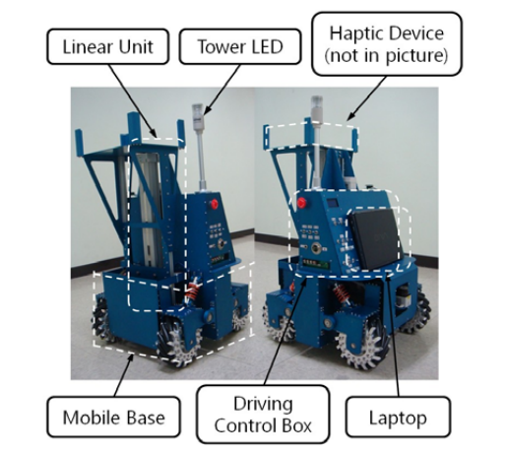
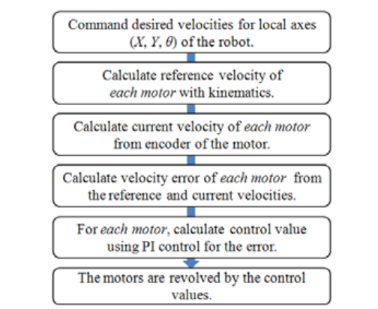
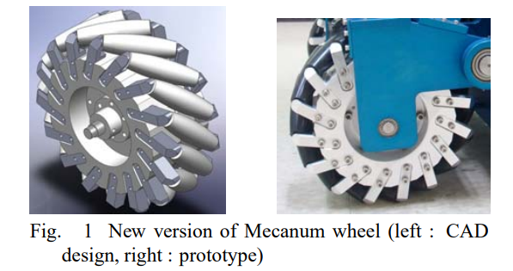
Design and Control of Mobile Robot with Mecanum Wheel Keywords: Mobile robot, mecanum wheel, omni-directional robot, fuzzy system
Objective: To design and control a holonomic mobile robot using four Mecanum wheels, resolving instability issues in their prior version through structural redesign and a new wheel model.
Wheel & Structure Design: Introduced a custom Mecanum wheel and redesigned chassis structure to improve balance and motion stability.
Control Method: Employed fuzzy-gain scheduling a fuzzy logic-based tuning mechanism for motor speed control, replacing simple PID, to handle nonlinearity and suspension-induced disturbances.
Experimental Results: Demonstrated superior performance smoother omni-directional motion, reduced oscillations compared to their previous platform.

Slide 9
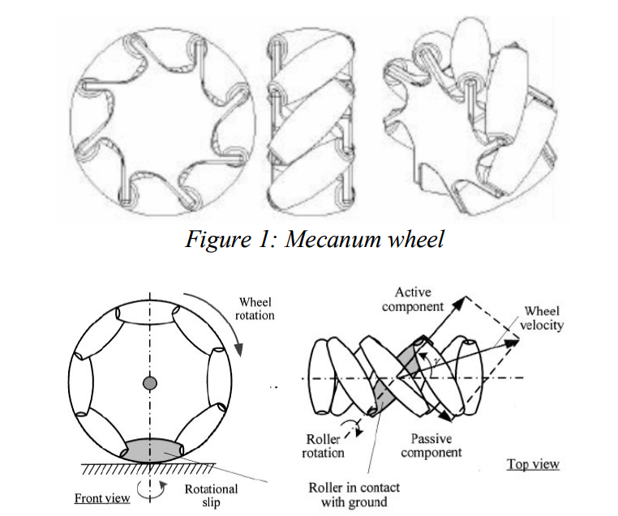
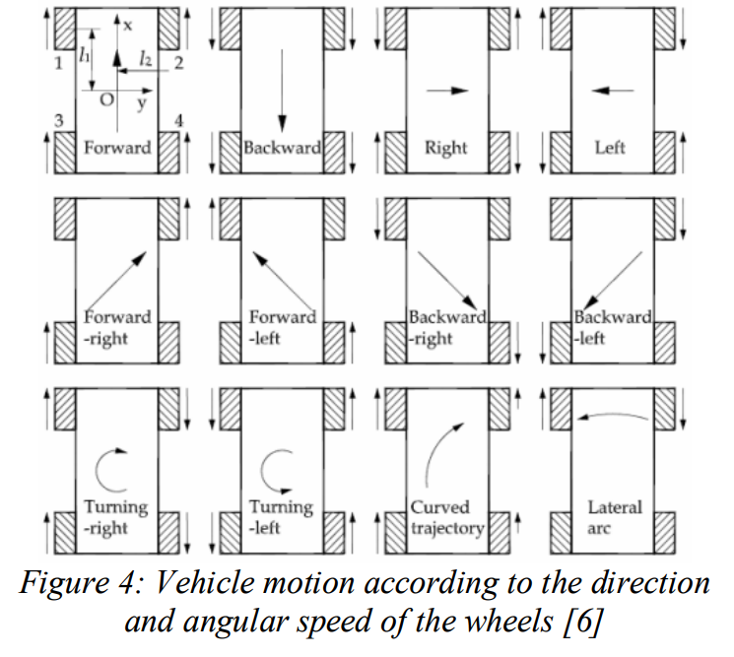
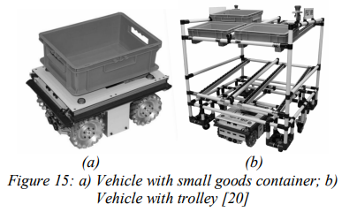
Practical applications for mobile robots based on Mecanum wheels - a systematic survey Keywords: Mecanum wheel, omnidirectional mobile robot, AGV
Abstract & Objectives:
This foundational survey outlines the omnidirectional mobility of four‑wheel Mecanum platforms, enabling instantaneous movement in any direction without rotation. It emphasizes deployment in constrained indoor environments, particularly factories, warehouses, hospitals, and labs, where tight spaces and dynamic obstacles prevail. The review covers the wheel design, mechanics, comparisons to conventional wheels, and practical systems deployed across multiple domains: industrial, military, naval, medical, and educational research

Slide 10
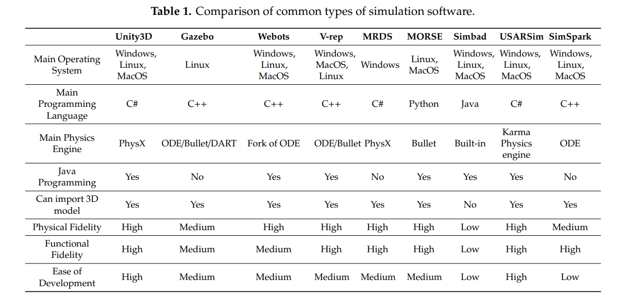
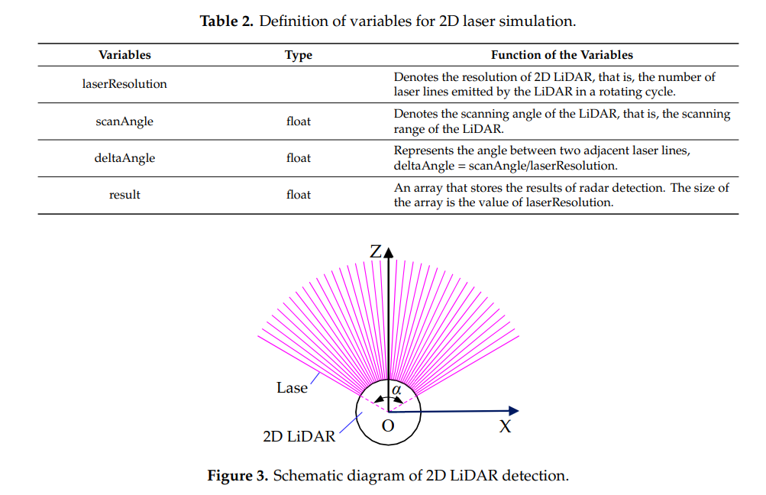
Navigation Simulation of a Mecanum Wheel Mobile Robot Based on an Improved A* Algorithm in Unity3D
Keywords: navigation simulation; path planning; improved A* algorithm; Unity3D; Mecanum wheel robot
Abstract & Objectives
The research proposes a method for simulating robot navigation based on an improved A* path‑planning algorithm integrated within Unity3D.
A virtual prototype of a Mecanum‑wheel robot is built using imported 3D model, simulated revolute joints and virtual LiDAR sensors.

Slide 11
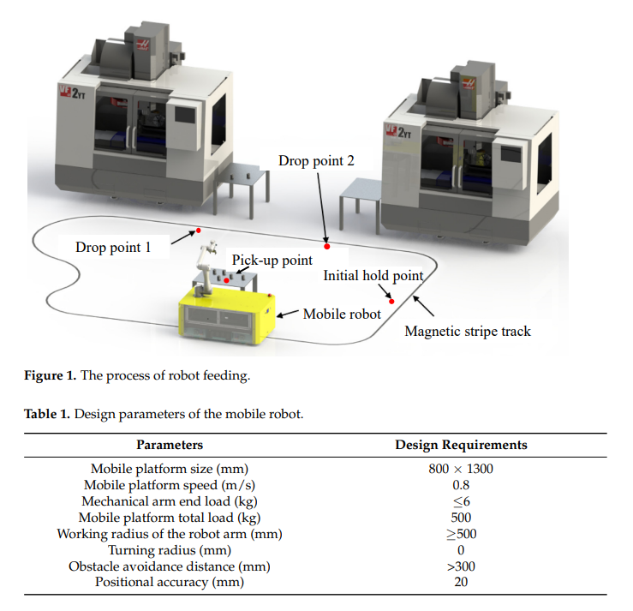
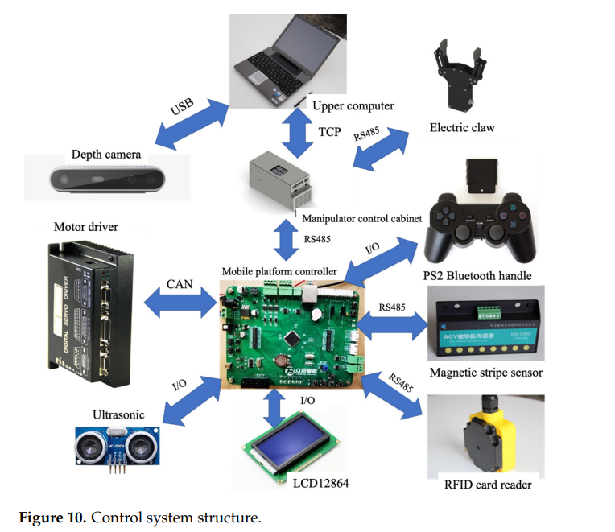
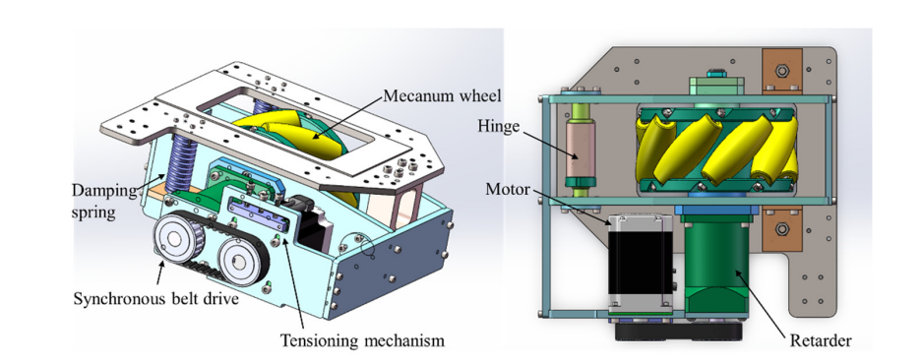
Design and Implementation of Omnidirectional Mobile Robot for Materials Handling among Multiple Workstations in Manufacturing Factories Keywords: mobile robot; mecanum wheel; magnetic strip tracking; machine vision; OpenCV
Integrated logistics robot: Seamlessly coordinates omnidirectional mobility and object grasping within a modular architecture.
Robust trajectory control: The fuzzy‑PID deviation correction enhances magnetic strip navigation accuracy, reducing path drift.
Vision-guided grasping: Real-world visual detection via Hough transform enables effective object pickup.
Open-source computing stack: Embedded RT-thread system ensures real-time coordination between mobile platform and manipulator.

Slide 12
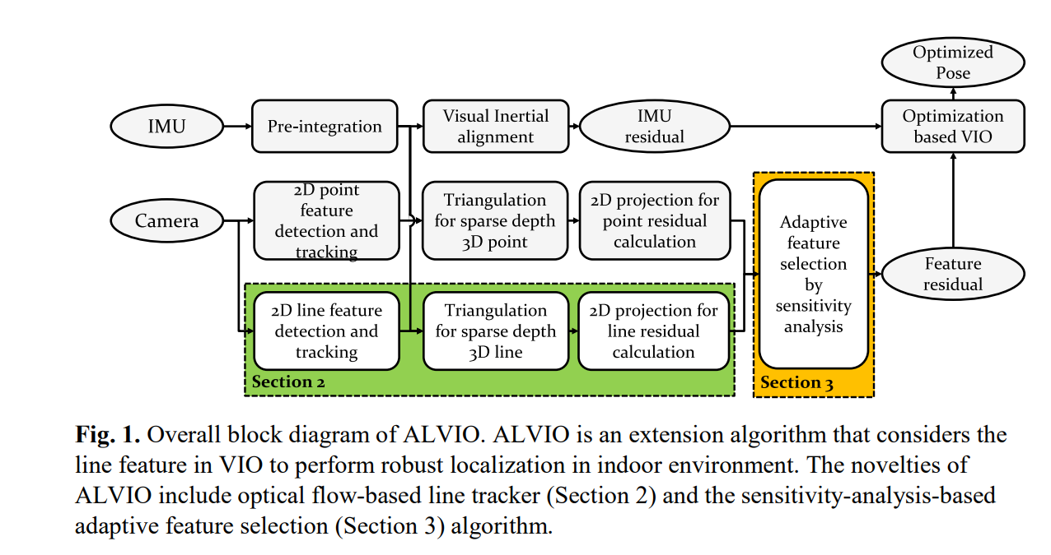
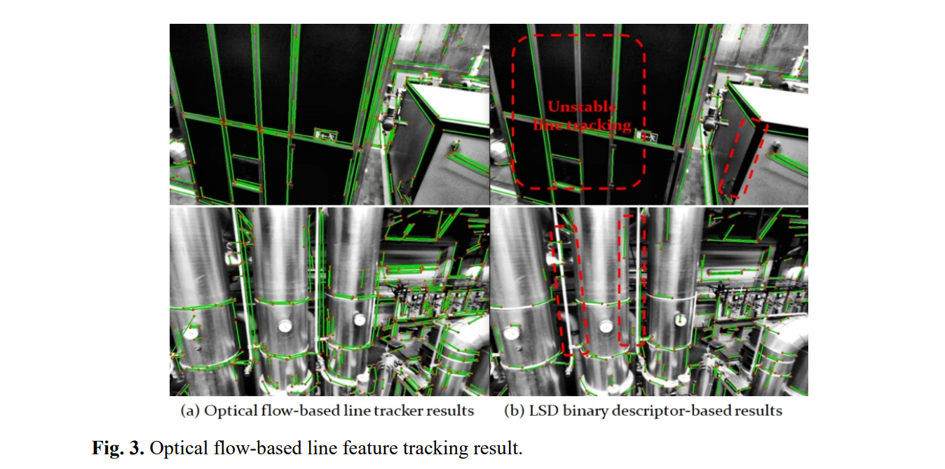
ALVIO: Adaptive Line and Point Feature-based Visual Inertial Odometry for Robust Localization in Indoor Environments Keywords: Visual Inertial Odometry (VIO), Visual Inertial Navigation System (VINS), 3D line features, sensitivity analysis, adaptive feature selection, indoor localization.
Problem Addressed: Indoor VIO systems often fail in areas with low texture or repetitive patterns since they rely only on point features.
Key Innovation: Introduces ALVIO, a tightly-coupled visual-inertial odometry that adaptively uses both line and point features based on feature sensitivity.
Line Tracking: Utilizes an optical-flow based line tracker to maintain robustness, accurate 3D line reconstruction via epipolar geometry.
Adaptive Feature Selection: Implements sensitivity-analysis to select the most informative features, balancing accuracy and computational load.
Evaluation: Tests on public datasets show a 16% improvement in translation RMSE over VINS‑Mono, with up to 49% reduction in optimization time, supporting real-time applicability.

Slide 13
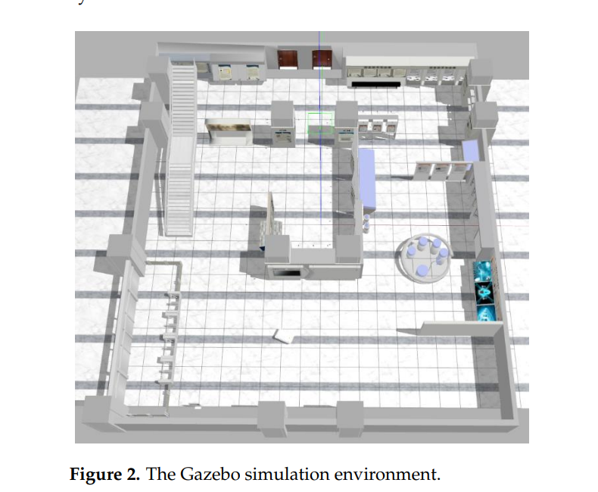
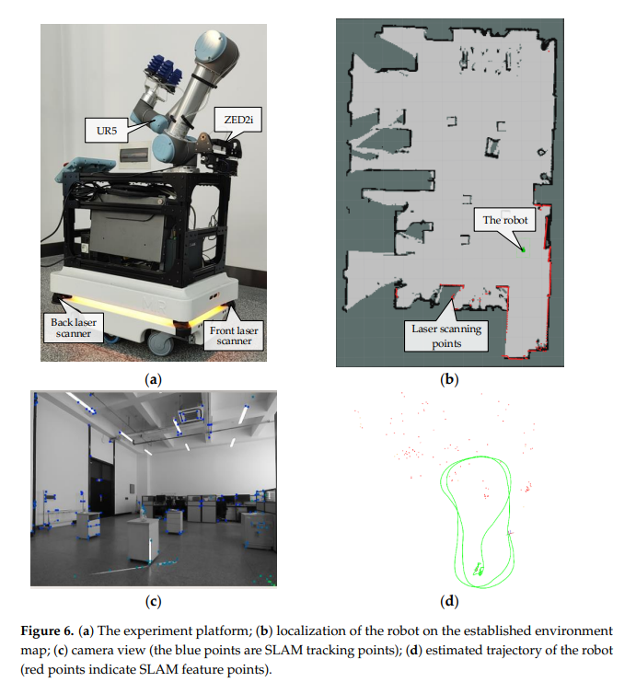
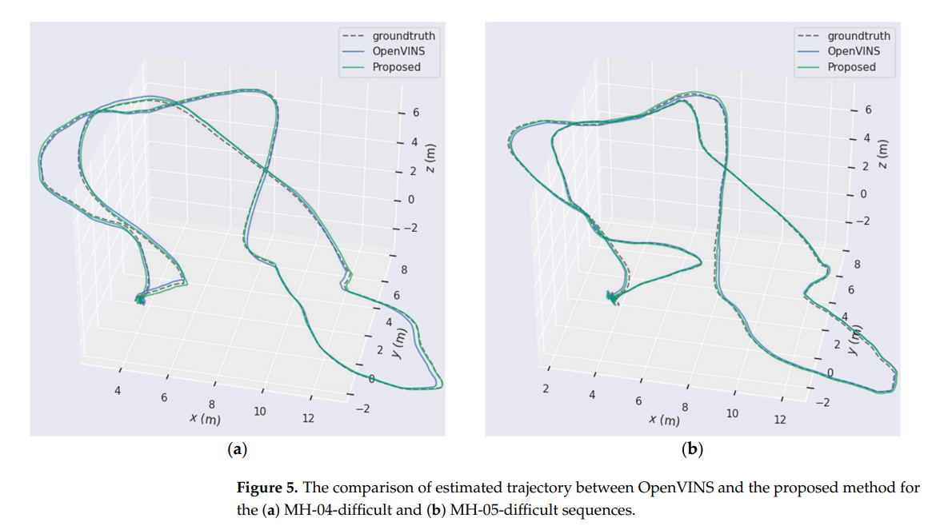
An Enhanced Hybrid Visual–Inertial Odometry System for Indoor Mobile Robot Keywords: mobile robot; visual–inertial odometry; IMU pre-integration; wheel odometry; Helmert variance component estimation
Presents an improved Visual‑Inertial Odometry (VIO) framework built upon the Multi-State Constraint Kalman Filter (MSCKF), optimized for indoor mobile robot localization.
Introduces IMU pre-integration as observation inputs into the MSCKF loop to leverage inertial data beyond prediction stages.
Utilizes Helmert Variance Component Estimation (HVCE) to adjust the fusion weights between visual feature measurements and IMU-derived motion inputs for enhanced localization fidelity.
Integrates wheel odometry (zero-speed detection and pre-integration updates) to further anchor the localization and reduce drift.
Validated across Gazebo simulation, public benchmark datasets, and real-world deployments, outperforming mainstream systems like OpenVINS in accuracy while retaining real‑time capability.

Slide 14
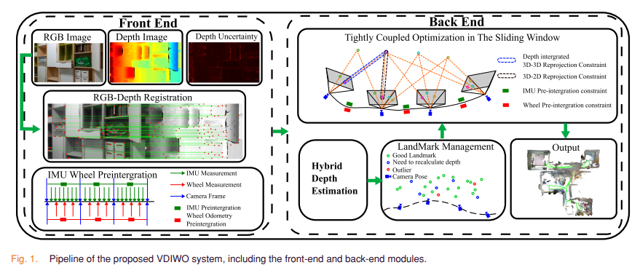
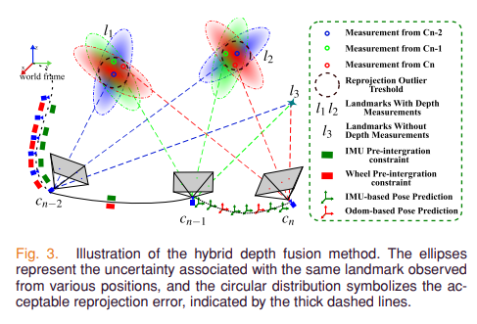
Robust Depth-Aided Visual-Inertial-Wheel Odometry for Mobile Robots Keywords: Sensor fusion, simultaneous location and mapping (SLAM), visual-inertial-odometer odometry, wheeled robots.
Proposes VDIWO, a tightly‑coupled odometry framework integrating RGB‑D depth, visual features, IMU, and wheel odometry for robust mobile robot localization in both indoor and outdoor settings.
Introduces a depth uncertainty model using a Gaussian Mixture Model to predict per-feature depth reliability.
Presents a hybrid depth estimation method combining depth sensor fusion and multiview triangulation to identify high‑quality landmarks.
Embeds visual reprojection errors, depth residuals, and wheel‑odometry preintegration constraints into a sliding‑window optimization backend.
Validated using OpenLORIS datasets and real‑world experiments; demonstrates high localization accuracy and robustness without needing prior maps.

Slide 15
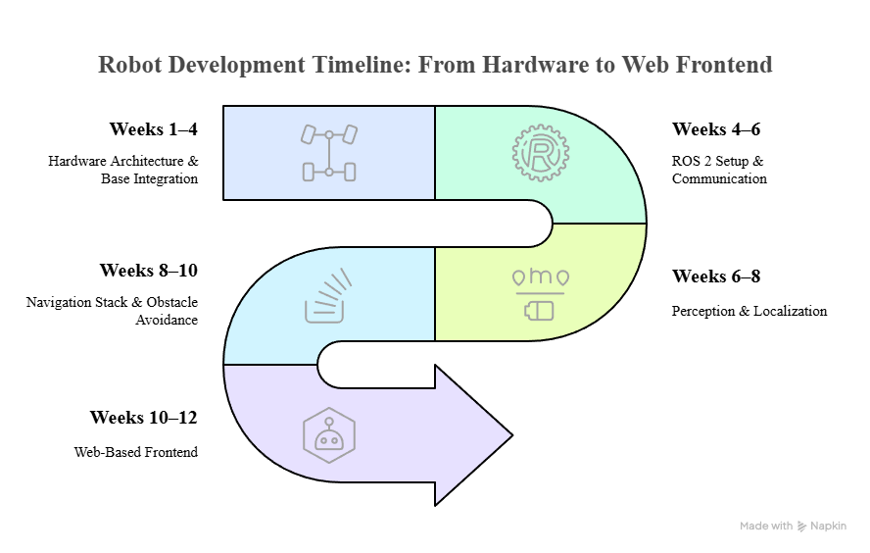

Slide 16
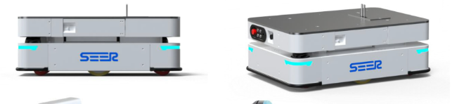
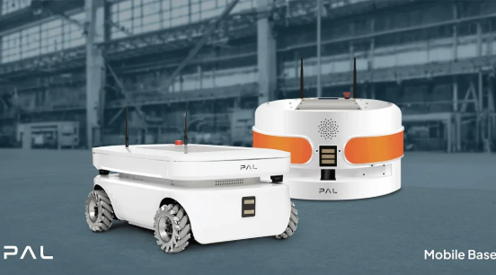
Reference Images

Slide 17
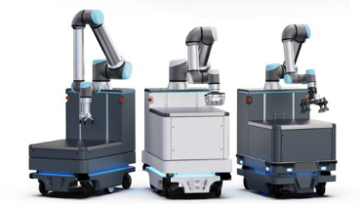
Reference Images

Slide 18
Difference between LiDAR Sensor and VIO
Aspect | VIO | LiDAR
Cost | Cheaper - cameras + IMU are low-cost | Expensive - LiDAR sensors are costly
Size & Weight | Compact & lightweight | Bulkier, often heavier
Power Consumption | Low power | Higher power draw
Environment | Works in textured environments (indoor, warehouse) | Struggles with glass, shiny surfaces
Pose Estimation | Can estimate full 6-DOF pose with IMU | Mostly gives depth data, pose needs extra processing
Data Fusion | Naturally fuses visual + inertial data | Needs fusion with IMU or camera separately
Appearance Awareness | Can detect visual features like signs, markers | Cannot interpret color/texture, only geometry

Slide 19
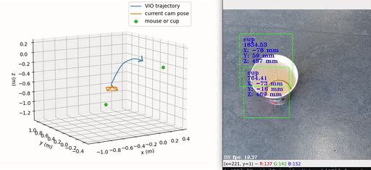
Example Implementation of VIO

